Slide 1
SUMMER OLYMPIC DATA ANALYSIS
SHUBHAM GOLAKIYA-200050131125

Slide 2



Introduction Description Results Conclusion
DATA ANALYSIS ON SUMMER OLYMPIC

Slide 3
This is Olympics Data Analysis Project created using Python and CSV file. It is an Exploratory Data Analysis on Summer Olympics Games from 1896 to 2012. I analysized the dataset from the Kaggle
INTRODUCTION

Slide 4


So for this project,we have a data file that contains the year,city,sports,discipline, athelate,country,gender,event and medal
DESCRIPTION

Slide 5


Following are the outcomes of the project which shows the analysis on the summer olympic.
RESULTS

Slide 6

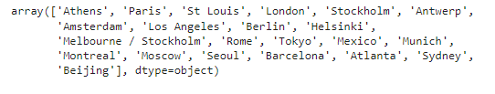
The results shows that so far in Summer Olympics have been held in these cities.

Slide 7
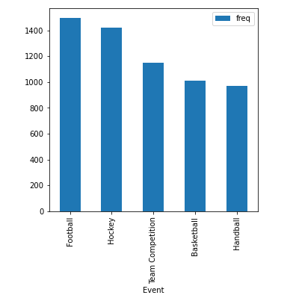
This graph explains the most popular event in terms of number of players.

Slide 8
The main Objective of this study was to Analyze and visualize the various factors which have contributed in the Evolution of Olympic Games over the years. These type of Analysis are very helpful as this type of Analysis can be performed by any Country or Player which can help them in analyzing their performance so that they can improve their performance by changing their strategies.
CONCLUSION

Slide 9
THANK YOU

